Slide 1

SURVEILLANCE WITH VISION
JERRIN BRIGHT, NISHANTH R, ROHITH R
18BME1004, 18BME1024, 18BME1020

Slide 2
PARTS
TECHNICAL PRODUCT DEVELOPMENT
DRONES
VISION
CAMERA
PRODUCT
PLANNING
ANALYSIS
PATENT

Slide 3
TECHNICAL - DRONES

Slide 4
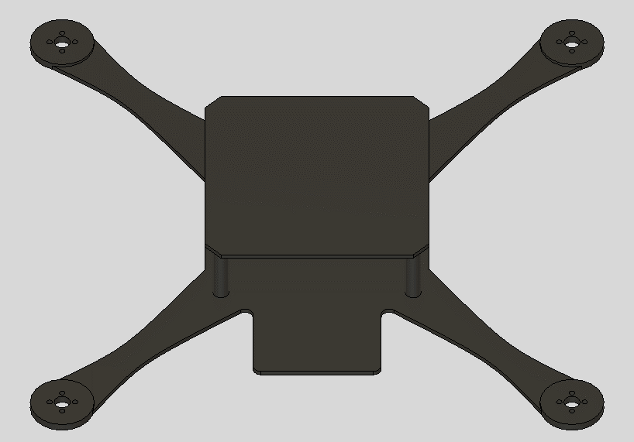
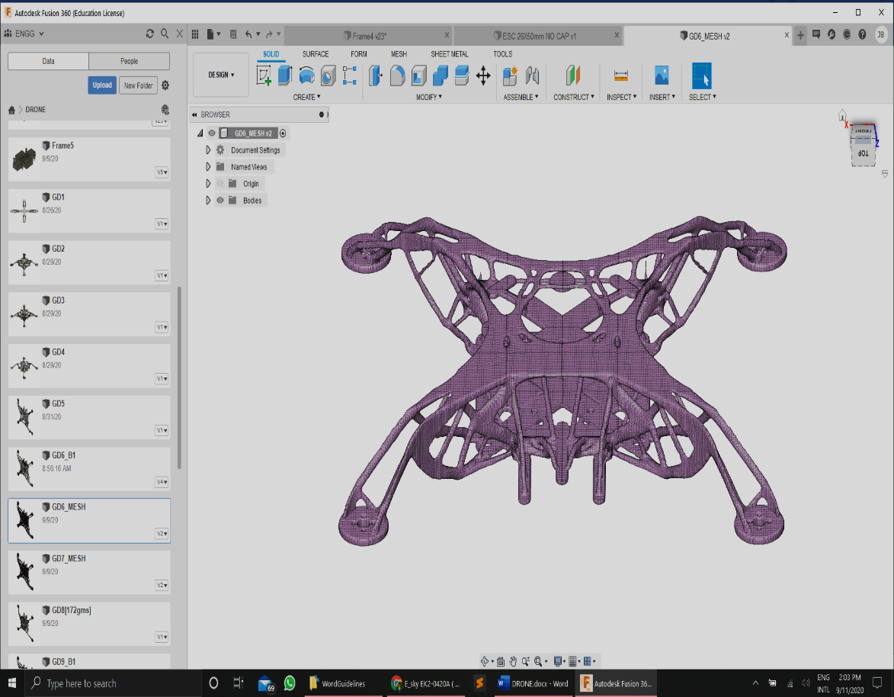
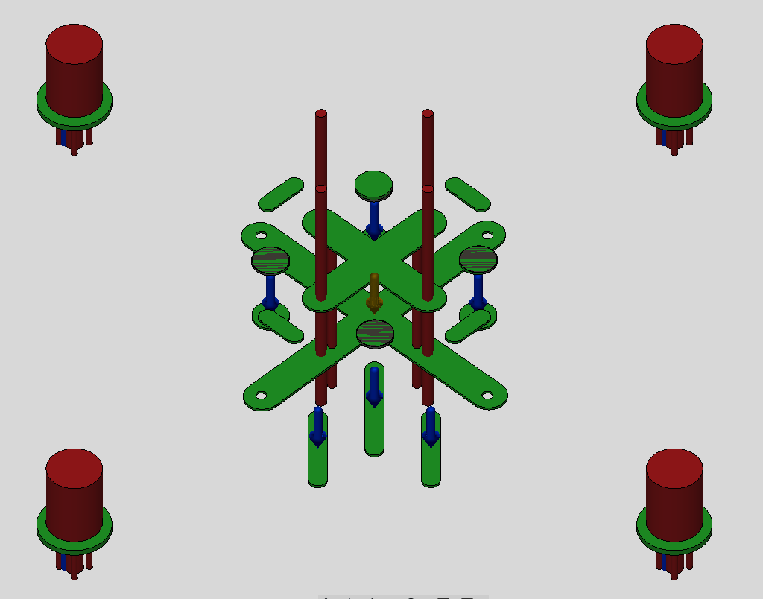
DRONE
GENERATIVE DESIGNING technique
designed IN AUTODESK FUSION 360
PAYLOAD - 1kg
TIME OF FLIGHT – UPTO 1HR
Min. factor of safety – 13.3

Slide 5
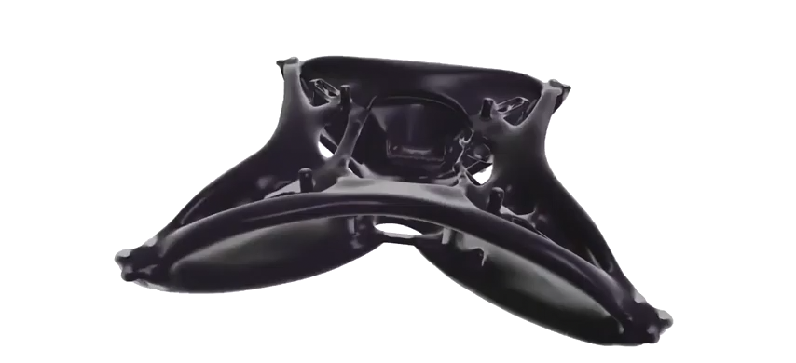
DRONE

Slide 6
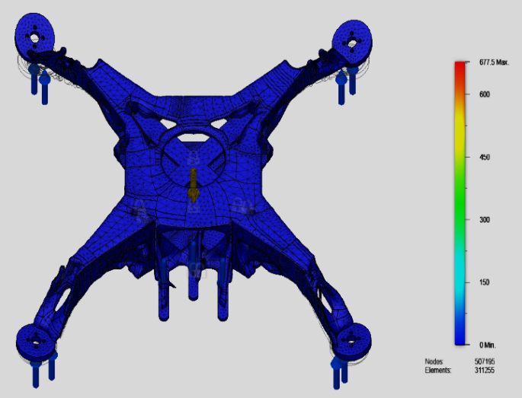
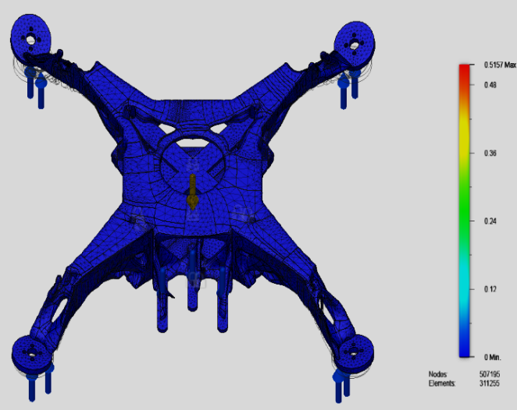
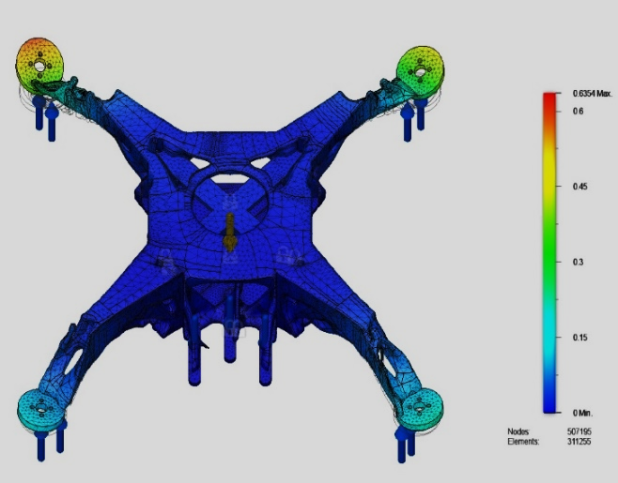
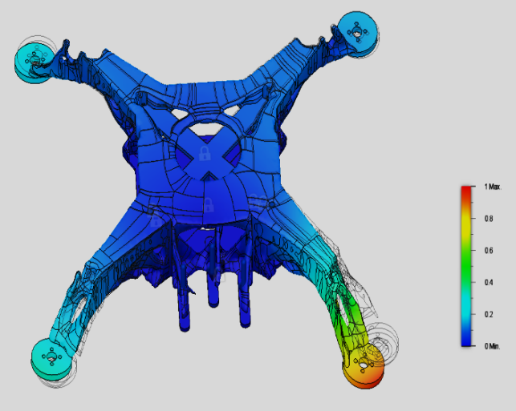
DRONE
VON MISES STRESS
STATIC STRAIN
GLOBAL
DISPLACEMENT
MODULAR
FREQUENCY

Slide 7
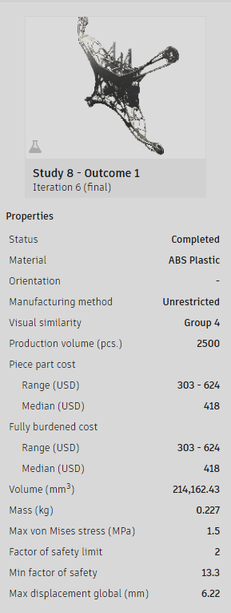
DRONE
ADVANTAGES:
LESS MASS, THUS:
FASTER
MORE FLIGHT TIME
CHEAPER
STRONGER [FOS – 13.3]
AGILE

Slide 8
TECHNICAL- CAMERA

Slide 9
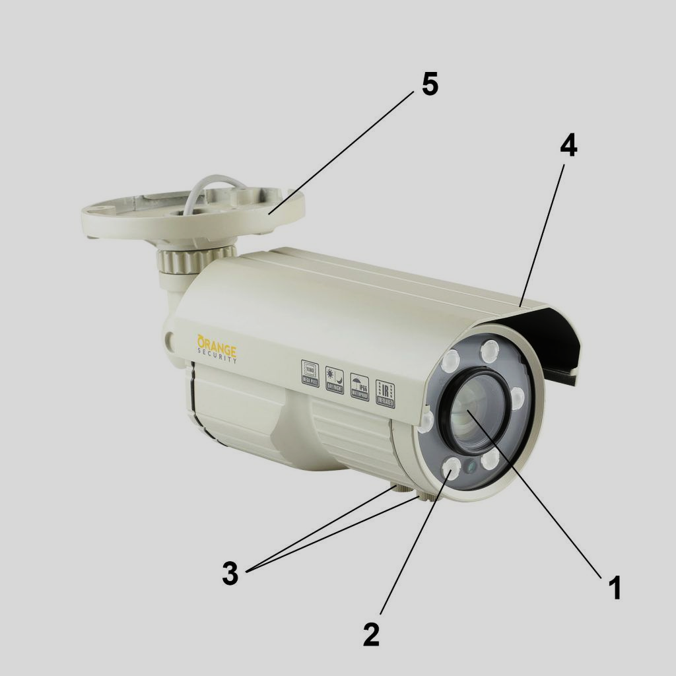
CAMERA
1.Camera lens
2. Infra-Red LED
3. Zoom and focus adjusters
4. Cowling
5. Bracket

Slide 10
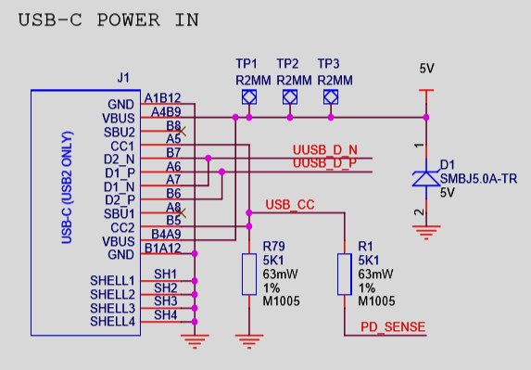
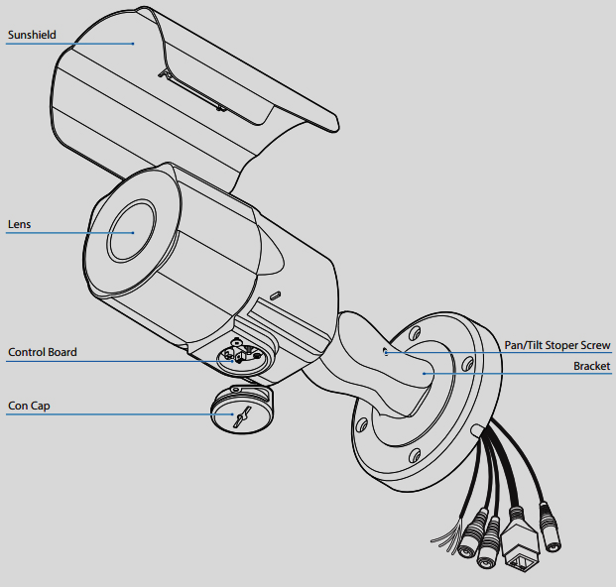
CAMERA
BULLET CAMERA - INTERIORS
PI CIRCUIT

Slide 11
TECHNICAL- VISION

Slide 12
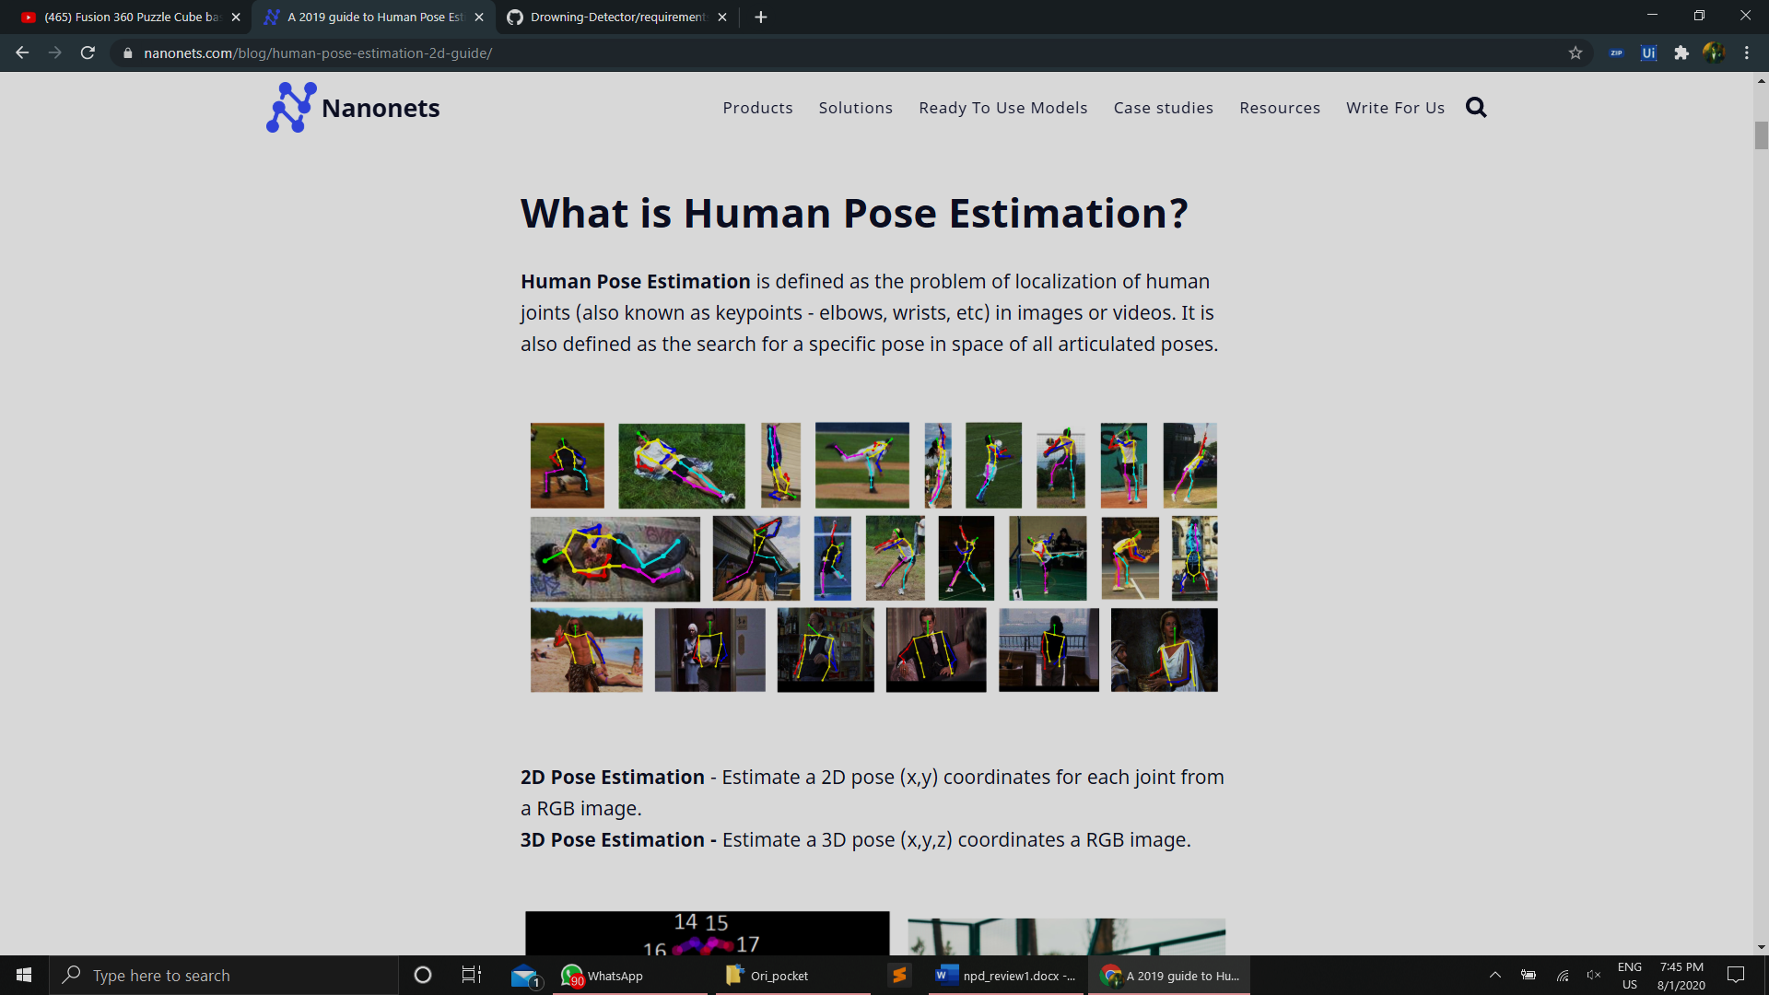
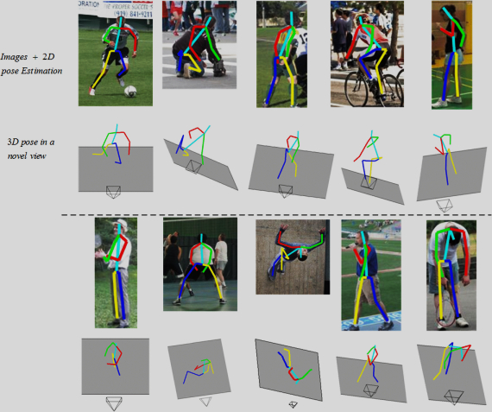
VISION
POSE ESTIMATION

Slide 13
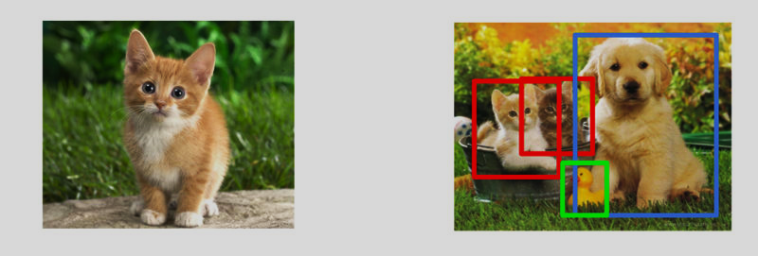
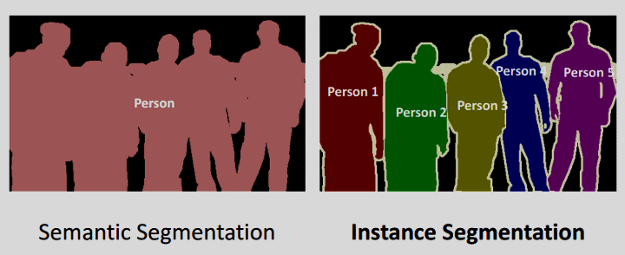
VISION
Image Classification
OBJECT DETECTION
INSTANCE SEGMENTATION
SEMANTIC SEGMNETATION

Slide 14
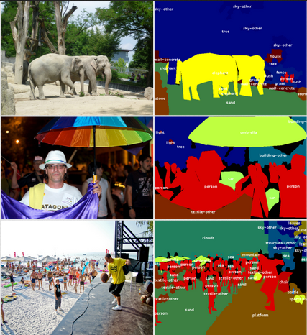
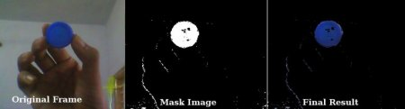
VISION
https://github.com/jerrie-bright/Semantic_Segmentation
/blob/master/deeplab.ipynb
HUE-SATURATION-Value
[HSV]
SEMANTIC SEGMENTATION

Slide 15
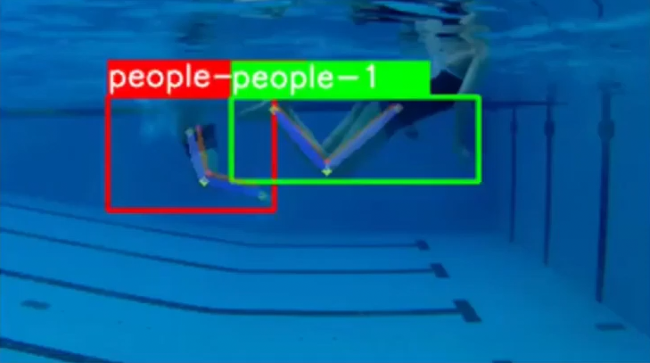
VISION

Slide 16
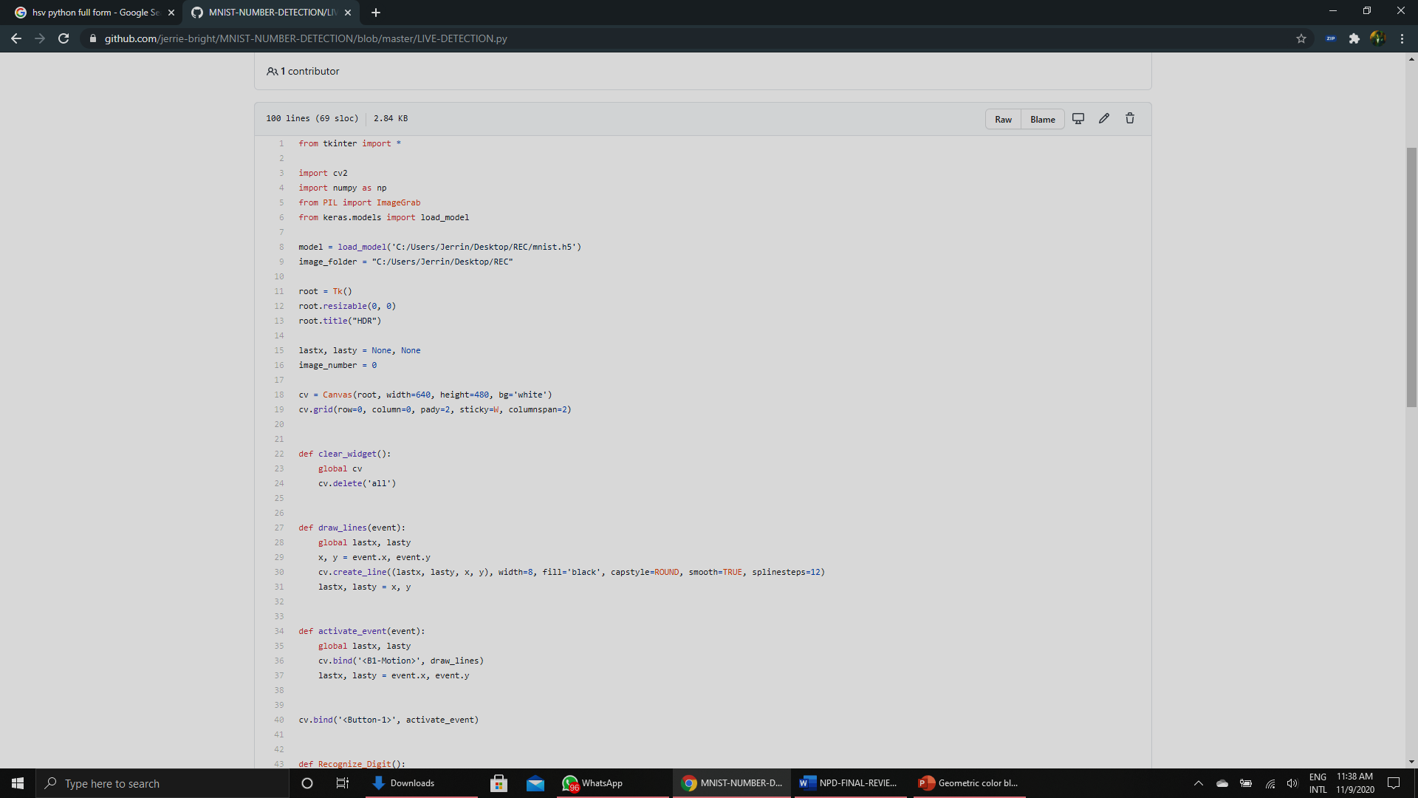
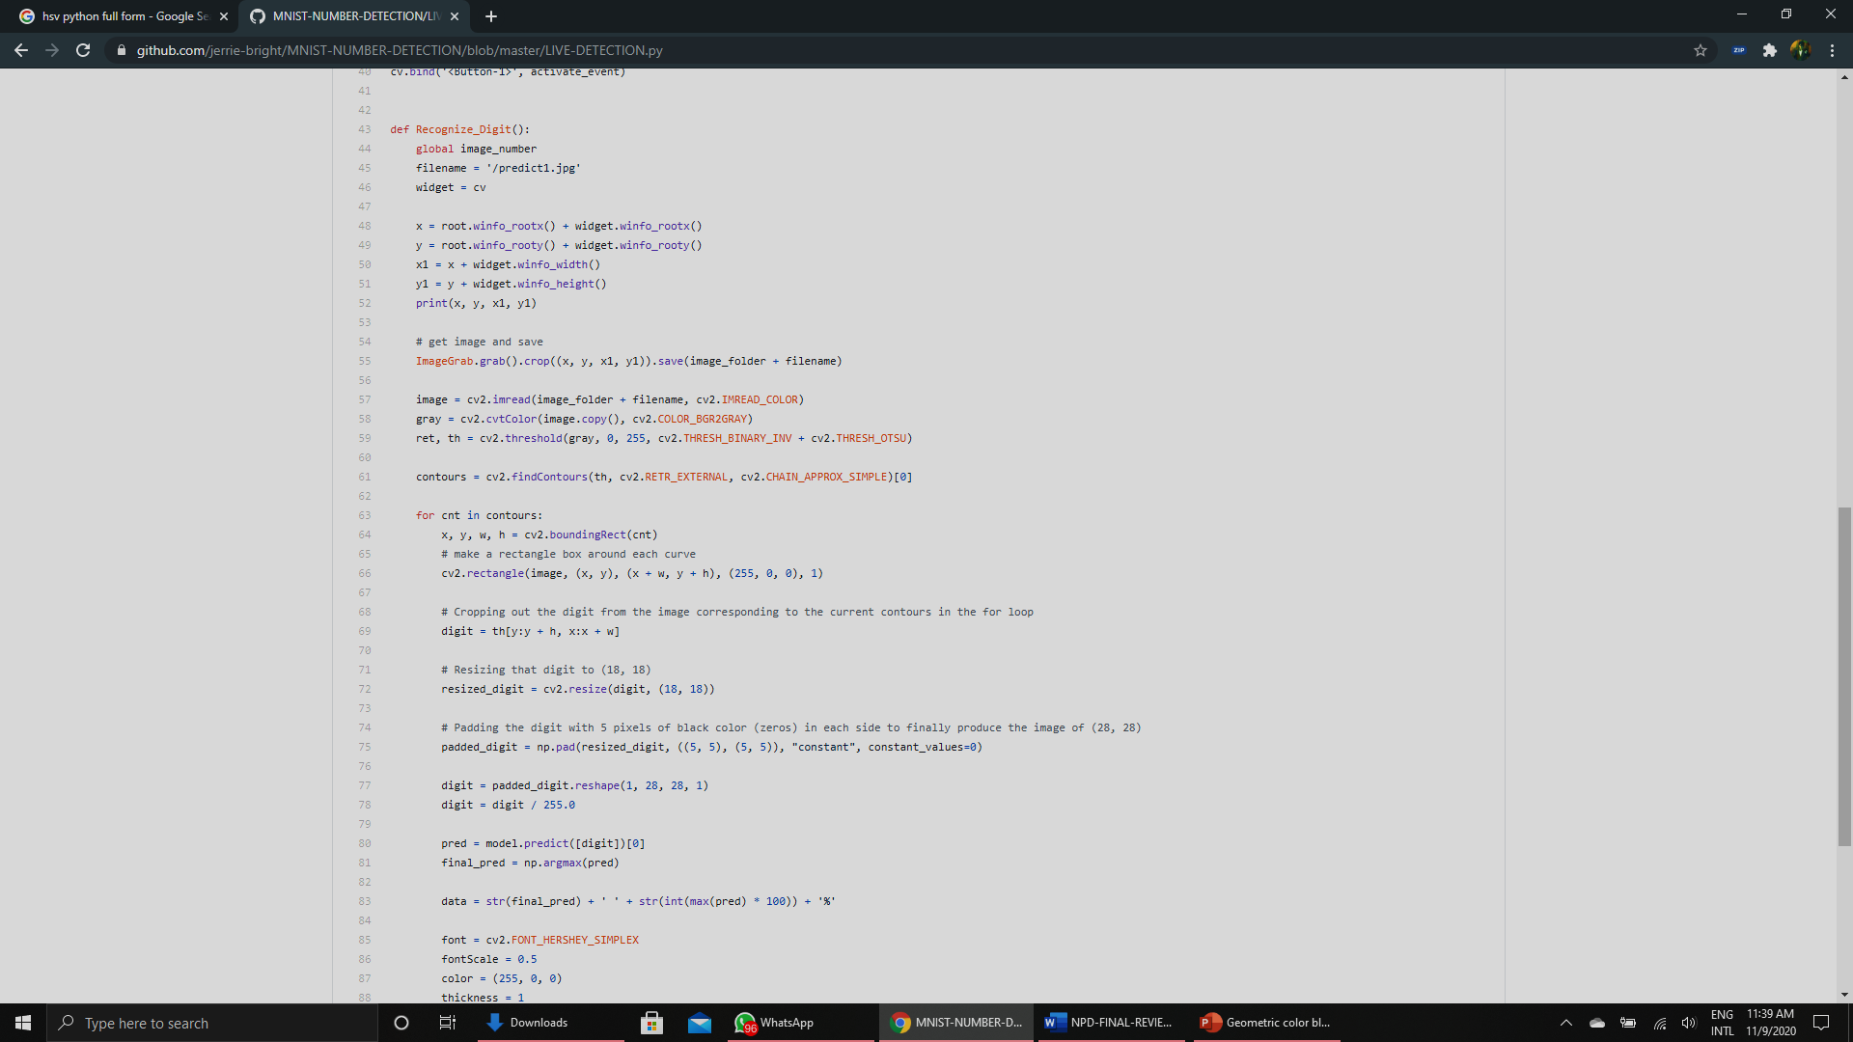
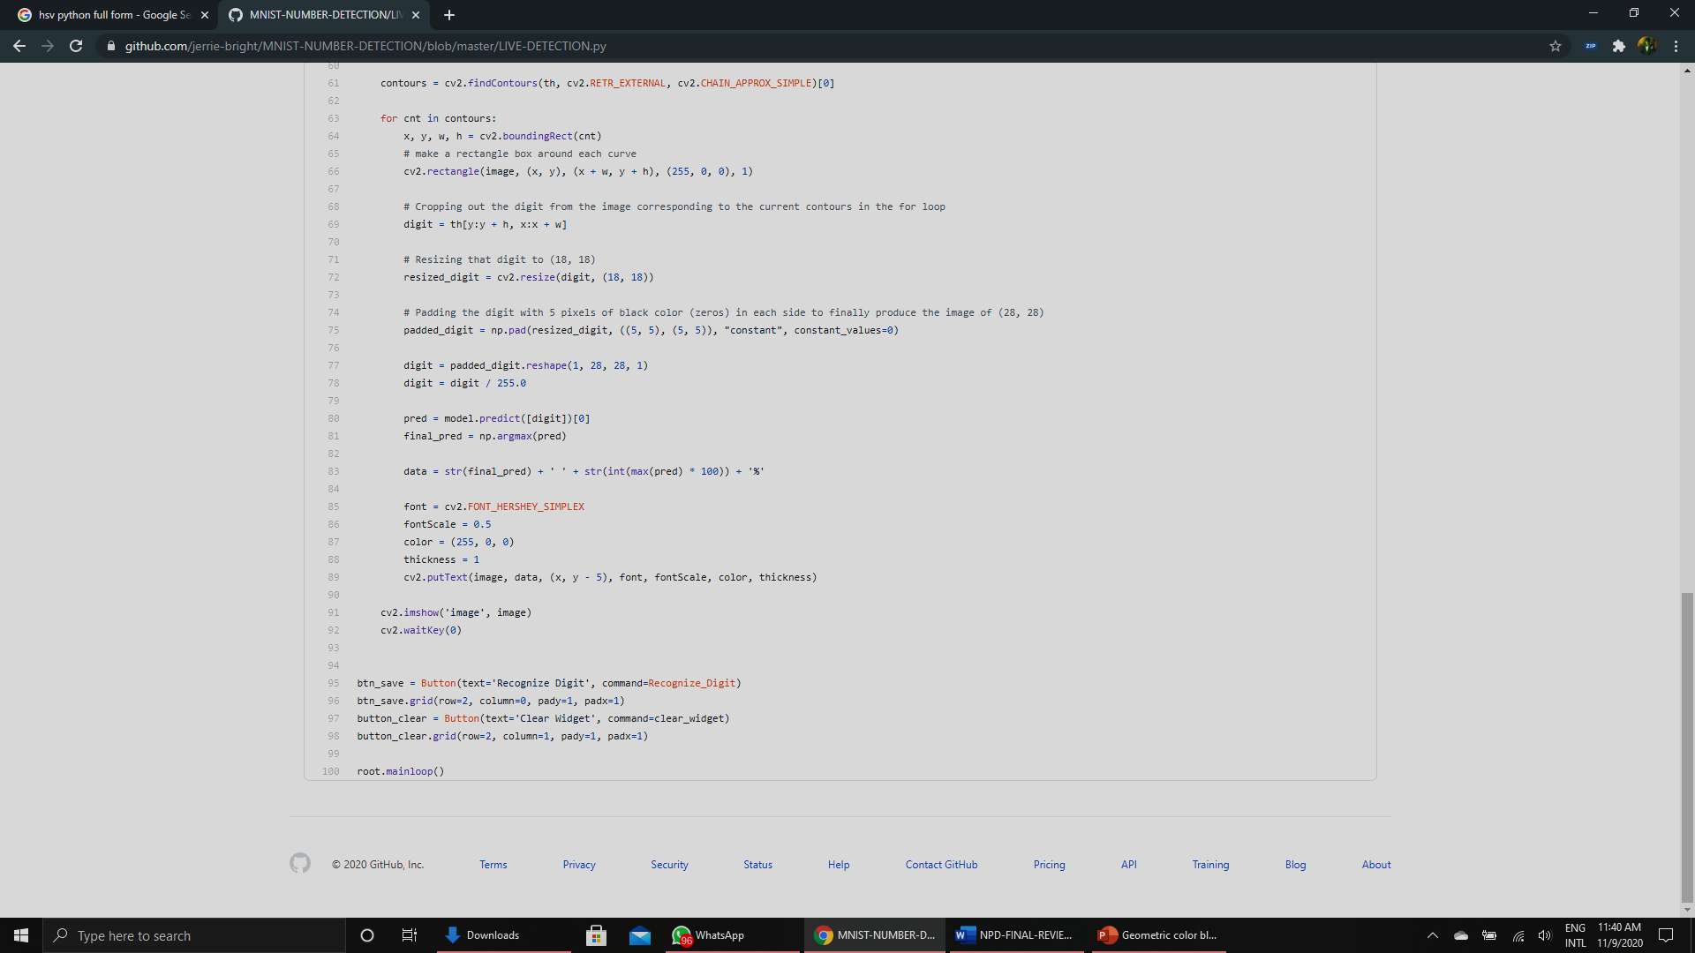
VISION

Slide 17
PRODUCT DEVELOPMENT - PLANNING TO EXECUTION

Slide 18
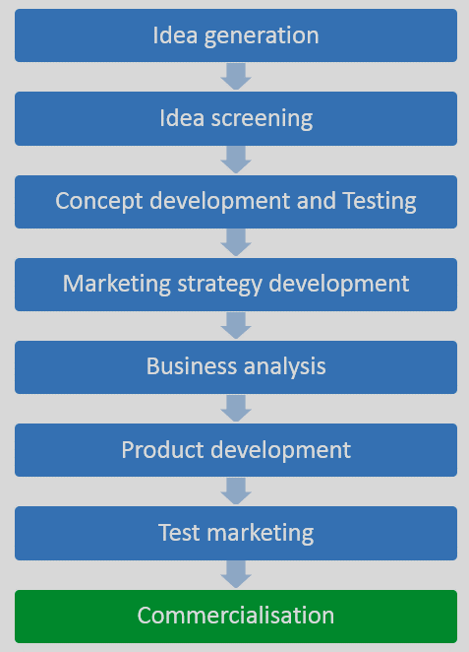
PLANNING TO EXECUTION

Slide 19
PRODUCT DEVELOPMENT - ANALYSIS

Slide 20
FAILURE MODE AND EFFECT ANALYSIS
PFMEA Process Failure Mode and Effects Analysis
Product / Part: | CAMERA AND DRONE |  | Team:
Project: | SURVEILLANCE WITH VISION |  | Engineer: | MECHANICAL |  |  |  |  |  | Revision Date: |  |  | 9/11
Item | Functions | Failure Mode | Effects | Severity | Causes |  |  | RPN | Recommended Action | Result
 |  |  |  |  |  | Occurrence | Detection |  | Action | Severity | Occurrence | Detection | Detection | RPN
CAMERA | PURPOSE OF OBSERVING AN AREA | 24 hr HUMAN SURVEILLANCE NOT PRACTICALLY POSSIBLE | THEFT MIGHT HAPPEN | 9 | DANGER | 6 | 6 | 324 | IMPLEMENTING COMPUTER VISION | 5 | 3 | 4 | 4 | 60
DRONE | SURVEILLANCE | BATTERY LIFE | LESS FLIGHT TIME | 7 | FAIL TO REACH DESIRED DESTINATION | 7 | 7 | 343 | INCREASING BATTERY CAPACITY | 4 | 4 | 4 | 4 | 64
 |  |  |  |  |  |  |  |  |  |  |  |  |  | 124

Slide 21
HOUSE OF QUALITY CHART
 | Correlations
 | Positive |  |  | +
 | Negative |  |  | −
 | No Correlation
 | Relationships
 | Strong |  |  | ●
 | Moderate |  |  | ○
 | Weak |  |  | ▽
 | Direction of Improvement
 |  |  |  |  |  |  |  |  |  |  |  |  |  |  |  |  | −
 | Maximize |  |  | ▲
 |  |  |  |  |  |  |  |  |  |  |  |  |  |  | + |  |  |  | −
 | Target |  |  | ◇
 |  |  |  |  |  |  |  |  |  |  |  |  | − |  |  |  | − |  |  |  | +
 | Minimize |  |  | ▼
 |  |  |  |  |  |  |  |  |  |  | + |  |  |  | − |  |  |  | + |  |  |  | −
 |  |  |  |  |  | Column # |  | 1 |  |  |  | 2 |  |  |  | 3 |  |  |  | 4 |  |  |  | 5 |  |  |  | 6 |  |  |  | 7 |  |  |  | 8 |  |  |  | 9 |  |  |  | 10 |  |  |  | 11 |  |  |  | 12 |  |  |  | 13 |  |  |  | 14 |  |  |  | 15 |  |  |  | 16
 |  |  |  |  |  | Direction of Improvement |  | ▲ |  |  |  | ▼ |  |  |  | ◇ |  |  |  | ▲ |  |  |  | ▲ |  |  |  |  |  |  |  |  |  |  |  |  |  |  |  |  |  |  |  |  |  |  |  |  |  |  |  |  |  |  |  |  |  |  |  |  |  |  |  |  |  |  |  |  |  |  |  | Customer Competitive Assesment
 | Row # | Weight Chart | Relative Weight | Customer Importance | Maximum Relationship |  | Functional Requirements | Max Resolution Support |  |  |  | Optical Zoom |  |  |  | Weight |  |  |  | StorageMedia Support |  |  |  | Battery |  |  |  |  |  |  |  |  |  |  |  |  |  |  |  |  |  |  |  |  |  |  |  |  |  |  |  |  |  |  |  |  |  |  |  |  |  |  |  |  |  |  |  |  |  |  |  | Our Product | Row #
 |  |  |  |  |  | Customer Requirements (Explicit and Implicit)
 | 1 | |||||||||| | 21% | 8 | 3 | Low Price |  | ▽ |  |  |  | ▽ |  |  |  | ○ |  |  |  | ○ |  |  |  | ○ |  |  |  |  |  |  |  |  |  |  |  |  |  |  |  |  |  |  |  |  |  |  |  |  |  |  |  |  |  |  |  |  |  |  |  |  |  |  |  |  |  |  |  |  |  |  |  | 4 | 1
 | 2 | |||||||||| | 21% | 8 | 9 | Good Quality |  | ● |  |  |  | ● |  |  |  | ▽ |  |  |  | ○ |  |  |  | ● |  |  |  |  |  |  |  |  |  |  |  |  |  |  |  |  |  |  |  |  |  |  |  |  |  |  |  |  |  |  |  |  |  |  |  |  |  |  |  |  |  |  |  |  |  |  |  | 4 | 2
 | 3 | ||||||| | 15% | 6 | 3 | Easy To Operate |  | ▽ |  |  |  | ▽ |  |  |  | ○ |  |  |  | ▽ |  |  |  | ▽ |  |  |  |  |  |  |  |  |  |  |  |  |  |  |  |  |  |  |  |  |  |  |  |  |  |  |  |  |  |  |  |  |  |  |  |  |  |  |  |  |  |  |  |  |  |  |  | 3 | 3
 | 4 | ||||||||||||||||||||||||| | 50% | 4 | 9 | Vesatility |  | ○ |  |  |  | ○ |  |  |  | ● |  |  |  | ▽ |  |  |  | ▽ |  |  |  |  |  |  |  |  |  |  |  |  |  |  |  |  |  |  |  |  |  |  |  |  |  |  |  |  |  |  |  |  |  |  |  |  |  |  |  |  |  |  |  |  |  |  |  | 4 | 4
 | 5 | |||||||||||||||||||||||||||||| | 60% | 8 | 9 | Take Distant Image |  | ● |  |  |  | ● |  |  |  | ▽ |  |  |  | ▽ |  |  |  | ▽ |  |  |  |  |  |  |  |  |  |  |  |  |  |  |  |  |  |  |  |  |  |  |  |  |  |  |  |  |  |  |  |  |  |  |  |  |  |  |  |  |  |  |  |  |  |  |  | 3 | 5
 | 6 | |||||||||||||||||||| | 40% | 5 | 3 | Portability |  | ▽ |  |  |  | ▽ |  |  |  | ○ |  |  |  | ▽ |  |  |  | ▽ |  |  |  |  |  |  |  |  |  |  |  |  |  |  |  |  |  |  |  |  |  |  |  |  |  |  |  |  |  |  |  |  |  |  |  |  |  |  |  |  |  |  |  |  |  |  |  | 3 | 6
 |  |  |  |  |  | Target |  | 1080p |  |  |  | 10x |  |  |  | 550g |  |  |  | 6gb |  |  |  | 10days/2hrs of charge
 |  |  |  |  |  | Max Relationship |  | 9 |  |  |  | 9 |  |  |  | 9 |  |  |  | 3 |  |  |  | 9
 |  |  |  |  |  | Technical Importance Rating |  | 950.51 |  |  |  | 950.51 |  |  |  | 758.21 |  |  |  | 800.5 |  |  |  | 850
 |  |  |  |  |  | Relative Weight |  | 22% |  |  |  | 22% |  |  |  | 18% |  |  |  | 24% |  |  |  | 14%
 |  |  |  |  |  | Weight Chart |  | ||||||||||| |  |  |  | ||||||||||| |  |  |  | |||||||| |  |  |  | |||||||||||| |  |  |  | |||||||
 |  |  |  |  | Technical Competitive Assesment | Our Product |  | 1 |  |  |  | 3 |  |  |  | 4 |  |  |  | 2 |  |  |  | 3
 |  |  |  |  |  | Column # |  | 1 |  |  |  | 2 |  |  |  | 3 |  |  |  | 4 |  |  |  | 5 |  |  |  | 6 |  |  |  | 7 |  |  |  | 8 |  |  |  | 9 |  |  |  | 10 |  |  |  | 11 |  |  |  | 12 |  |  |  | 13 |  |  |  | 14 |  |  |  | 15 |  |  |  | 16

Slide 22
PRODUCT DEVELOPMENT - PATENT

Slide 23
PATENT
Write down the invention (idea or concept) with as much details as possible
include drawings, diagrams or sketches explaining working of invention
check whether the invention is patentable subject matter
Patentability search & Decide whether to go ahead with patent
Draft (write) patent application
Publication of the application
Request for examination

Slide 24
THANK YOU!!!

